Slide 1

Walkerton Vacant Lots

Slide 2
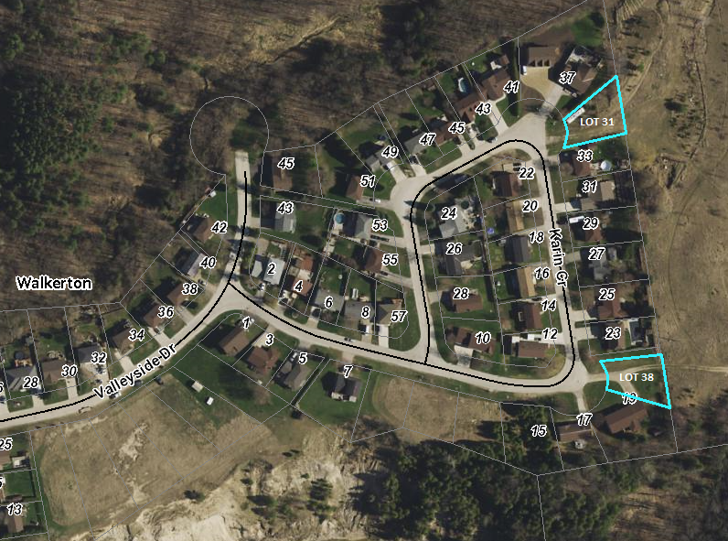
Karin Crescent
Lot 31: 61’ x 125’
Lot 38: 73’ x 121’

Slide 3
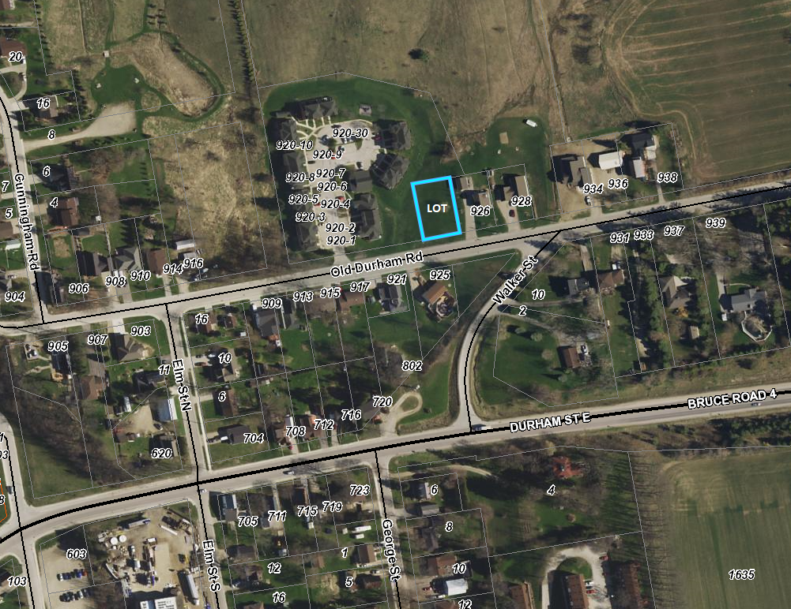
Old Durham Road
Lot: 82’ x 124’

Slide 4
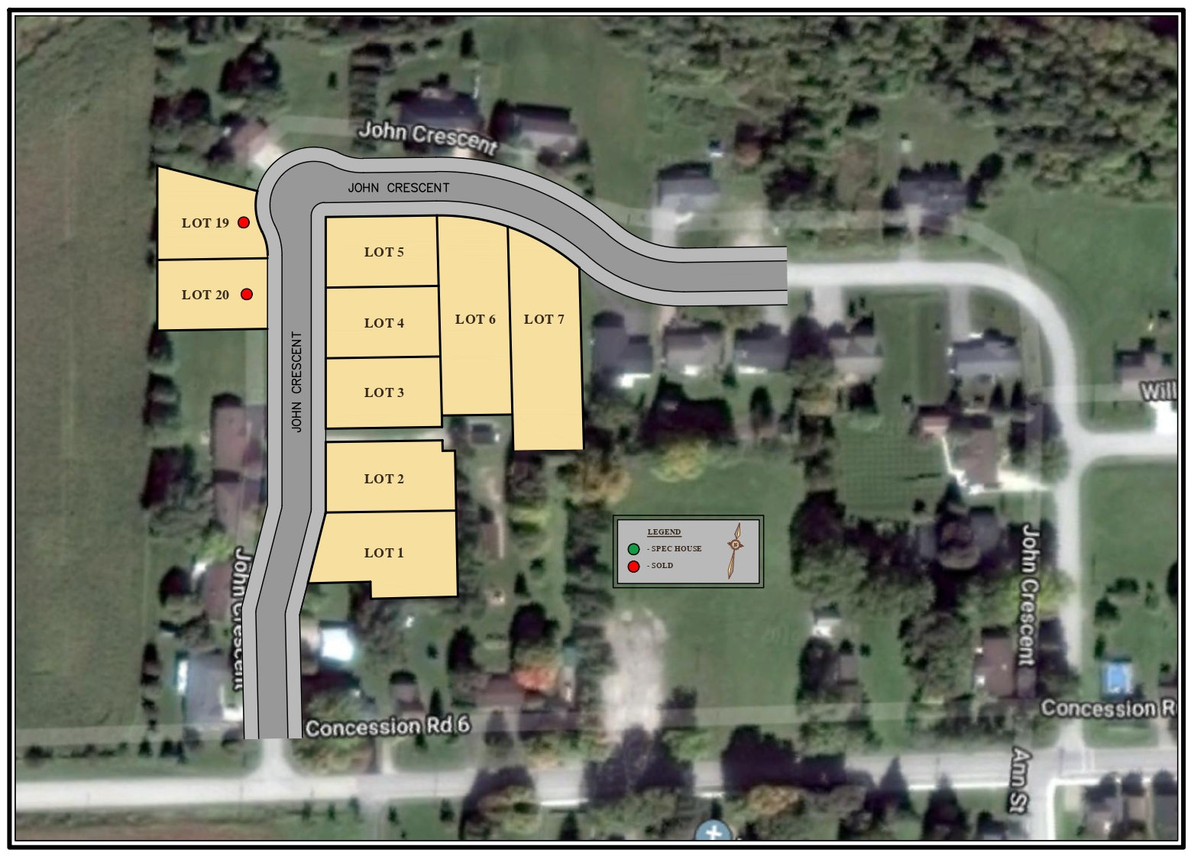
John Crescent - Chepstow
Lot 1: 83’ x 148’
Lot 2: 80’ x 146’
Lot 3: 80’ x 130’
Lot 4: 80’ x 128’
Lot 5: 80’ x 126’
Lot 6: 82’ x 213’
Lot 7: 94’ x 213’

